Slide 1

UnityMedia
By Logan Wright

Slide 2

Company Overview
Mission: Connect athletes to fans, coaches, and scouts
Content: Athlete information, game clips, reports, interviews
Environment: Positive, talent-focused
Platforms: YouTube, Twitch, Kick

Slide 3
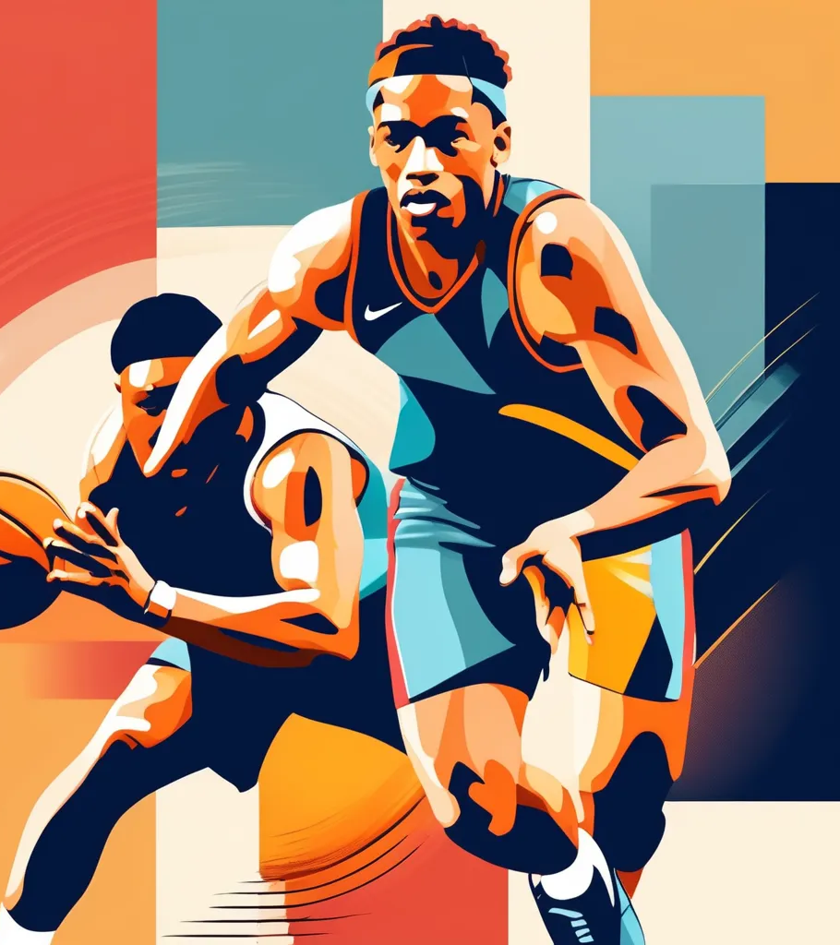
Market Opportunity
Trend: Increase in social media and digital content
Target Market: Tech-savvy sports fans (18-40), coaches, scouts, athletes
Geographic Focus: U.S. initially, global in 5 years
Online Streaming: Focus on Online platform for more freedom

Slide 4
Revenue Model
Subscription Plans: Premium content access on Patreon
Advertising: Display ads, video ads, sponsored content
Partnerships: Sports brands and affiliated bodies
E-commerce: Apparel, accessories, branded training equipment
Donations: Fan support options

Slide 5

Product and Service Offering
Live Streaming: Real-time game broadcasts
Exclusive Interviews: Athletes, scouts, coaches
Community Forums: Fan interaction
Athlete Profiles: Stats, videos, accomplishments
Game Highlights: Social media and video platforms

Slide 6
Marketing Strategy
Social Media: Active engagement on Instagram, Twitter, TikTok, YouTube
Influencer Partnerships: Endorsements from sports personalities
Content Marketing: High-quality articles, videos, podcasts
SEO and SEM: Increase traffic through optimization
Events and Promotions: live events and athlete showcases

Slide 7
Implementation Timeline
Month 1-2: Market analysis, business plan, investment capital
Month 3: Finalize business plan
Month 4-6: establish partnerships
Month 7: Develop beta version
Month 8-9: Marketing campaigns, collect feedback
Month 10-12: Full platform deployment, intensify marketing, launch premium services

Slide 8

Financial Projections
Initial Investment: $150,000
Year 1 Revenue: $100,000
Year 1 Expenses: $120,000
Year 1 Net Loss: $20,000

Slide 9


